Slide 1
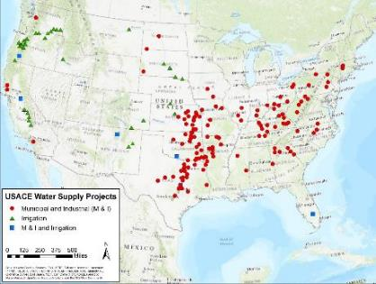
National portfolio assessment for reallocations
Brad Hudgens, PE, D.WRE
USACE Institute for Water Resources
October 30, 2020

Slide 2
WHERE we’ve been
Beginning in FY 2008
Collection and assessments of data related to:
Needs for water supply storage reallocation studies
Existing water supply agreements
Operational changes to Corps reservoir projects
Reservoir sedimentation
Uncertainty in future conditions affecting reservoir operations
Alternatives for funding reallocation studies
FY 2016 Report: Status and Challenges for USACE Reservoirs
FY 2015 – FY 2017: initial assessments of potential reallocation studies

Slide 3
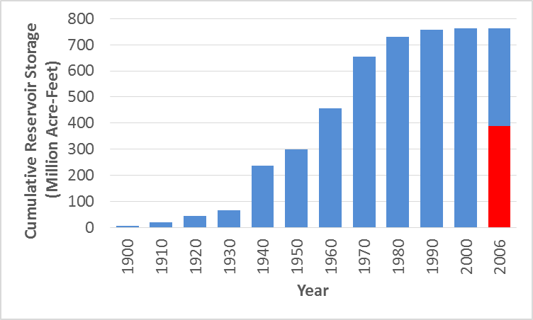
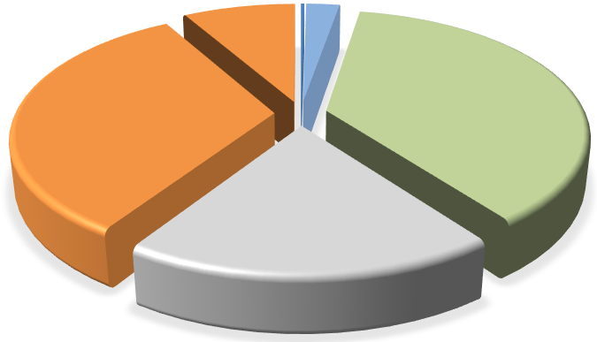
Example Assessment of Data Product: Reservoir Storage Space in the U.S.
USACE M&I
Water Supply Agreements
83,000 Dams
465 Dams [1]
(Reallocated)
(Original)
Sec. 7 [2]
Flood
(USACE)
(USACE)
Conservation
Notes:
[1] 465 multipurpose reservoir projects
with flood risk management storage
controlled by USACE
[2] “Section 7” projects are owned by other
agencies, but USACE prescribes operating
rules for flood risk management
(Sec. 7)
[2]
Storage in 465 Dams [1]

Slide 4
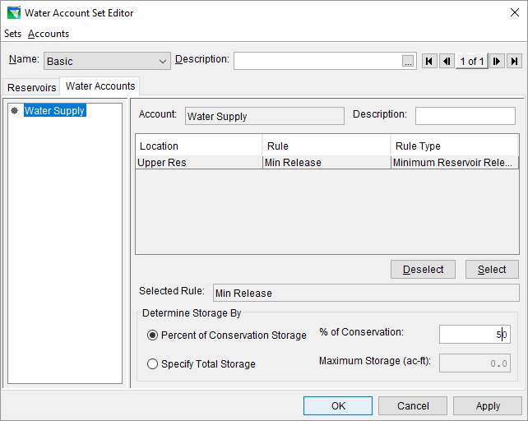
Training and tools for reallocation studies
Training for reallocation studies
Water supply alternatives formulation
Water demand forecasting
Storage-yield analyses
ECB 2019-13 “Methods for Storage-Yield Analysis”
Improvements to HEC-ResSim
Notes:
ECB – “Engineering and Construction Bulletin”

Slide 5
What we’re working on now
Continuing improvements to HEC-ResSim
Response to GAO Report 17-500, “Better Data Needed on Water Storage Pricing”, recommendations #1 and #2
IWR Report: “Technical Considerations in Storage Accounting”
Risk-informed yield analyses
Scoping update to the 1996 Institute for Water Resources Water Supply Handbook

Slide 6
Technical considerations in storage accounting?

Slide 7
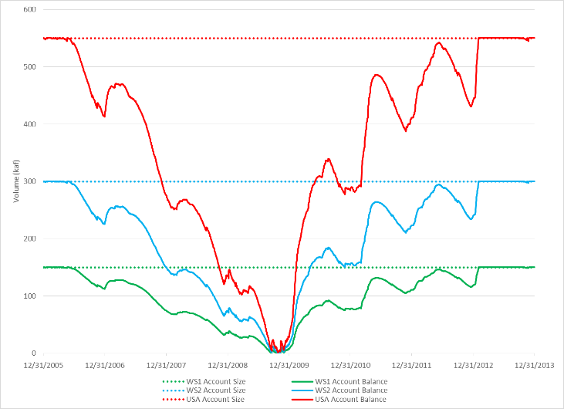
Technical considerations in storage accounting
Yield of Each User:
WS 1 – 245 cfs
WS 2 – 489 cfs
USA – 896 cfs
Total = 1,630 cfs

Slide 8
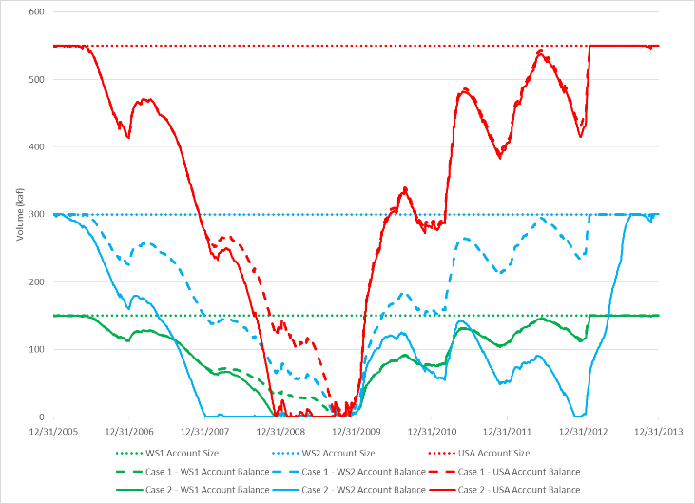
Technical considerations in storage accounting
Yield of Each User: Case 1: Case 2:
WS 1 – 245 cfs WS 1 – 245 cfs
WS 2 – 489 cfs WS 2 – 600 cfs
USA – 896 cfs USA – 896 cfs
Total = 1,630 cfs

Slide 9
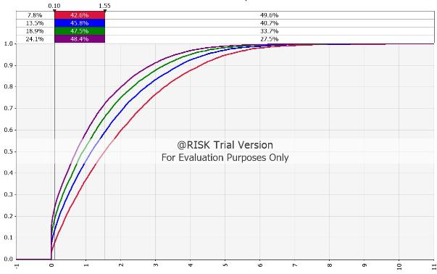
Risk-informed yield analyses?
ECB 2019-13 reviews methods for evaluating the reliability of firm yield.
EM 1110-2-1420 proposes a Shortage Index (SI):
$$SI= \frac{100\sum_{1}^{N}{{\left[\frac{S_{A}}{D_{A}}\right]}^{2}}}{N}$$
Notes:
ECB – “Engineering and Construction Bulletin”
EM – “Engineer Manual”

Slide 10
What we’re working on now
Continuing improvements to HEC-ResSim
Response to GAO Report 17-500, recommendations #1 and #2
IWR Report: “Technical Considerations in Storage Accounting”
Risk-informed yield analyses
Scoping update to the 1996 Institute for Water Resources Water Supply Handbook

Slide 11
Questions?
Technical
Analyses
Reallocation Decision?
USACE Authorities & Policies
Value of Project Outputs
Congress &
Administration
Stakeholders

