Slide 1
“Looking into the future” a civil works perspective
Presentation to the National Water Supply Association
Mr. Alvin B. Lee
Director of Civil Works
Headquarters
U.S. Army Corps of Engineers
29 October 2020

Slide 2
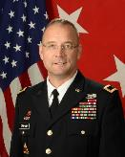
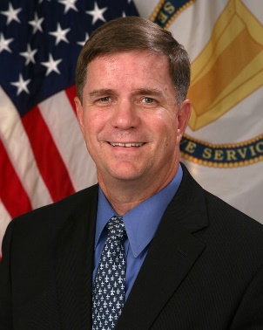
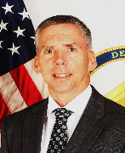
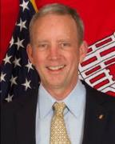
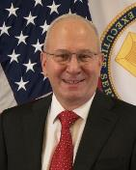
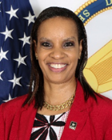
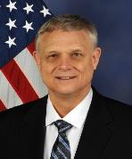
As of: 19 Oct 2020
Directorate of Civil Works
Awaiting Official Photo
Deputy Commanding General, Civil and Emergency Operations
MG William Graham ( 3L94 ) 761-0099 ( CECW-ZA )
Director of Civil Works
Mr. Alvin Lee ( 3L92 ) 761-0100 ( CECW-ZB )
Mr. Thomas Smith, P.E. Chief ( 3E92 ) 761-1983
Operations and Regulatory Division (CECW-CO)
Great Lakes and Ohio River Div. RIT ( CECW-LRD )
North Atlantic Div. RIT (CECW-NAD)
Mr. Eric Bush Acting Chief ( 3G92 ) 761-0115
Planning and Policy Division (CECW-P)
Mississippi Valley Div. RIT ( CECW-MVD )
Southwestern Div. RIT (CECW-SWD)
Mr. Stephen Hill Chief (3H53) 761-4714
Office of Homeland Security ( CECW-HS )
Director of Contingency Operations
Northwestern Div. & Pacific Ocean Div. RIT (CECW-NWD/POD)
Dr. Christine Altendorf, P.E. Chief ( 3H92 ) 761-8826
Engineering and Construction Division (CECW-EC )
South Atlantic Div. RIT (CECW-SAD)
South Pacific Div. RIT (CECW-SPD)
Ms. Stacey Brown Chief ( 3I92 ) 761-4100
Programs Integration Division (CECW-I )
Program & Project Management CoP
Dr. Joe Manous, P.E. Director (703) 428-7074
Institute for Water Resources (CEIWR)

Slide 3
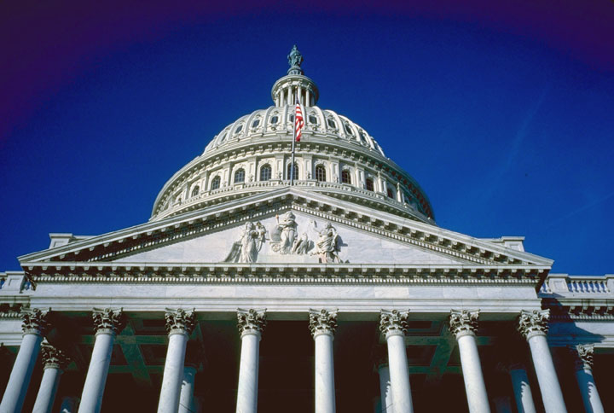
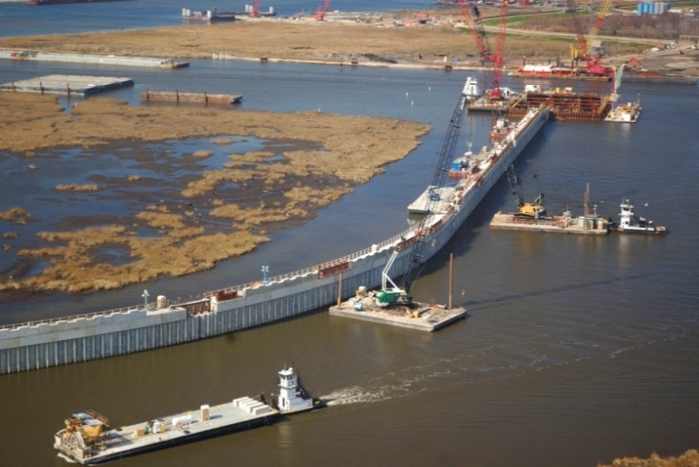
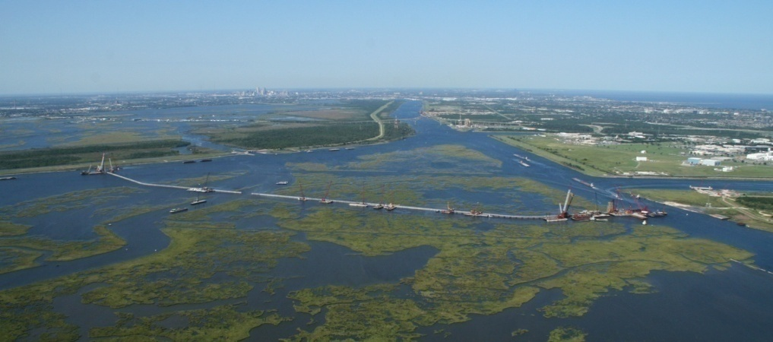
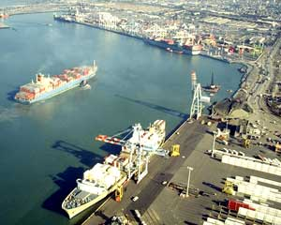
INVESTING IN THE NATION’S WATER INFRASTRUCTURE

Slide 4
completed Chief’s Reports since WRDA 2018 Enactment
FY 2019
FY 2020
FY 2021

Slide 5
Civil Works 2020 Study Completions
7 additional Chief’s Reports scheduled for completion in 2020
2 LRD, 1 SAD, 1 SPD
2 NAD
1 NWD
10

Slide 9
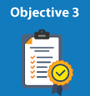
CIVIL WORKS
Accelerate Project Delivery
Transform
Project Financing & Budgeting
Successes:
Continuing Authorities Program
Risk Informed Decision Making
Delegations
Successes:
Public Private Partnerships (P3)
Corps Water Infrastructure Finance Program (i.e. WIFIA)
Improve Permitting &
Regulation Reform
Strategic
Engagement
Proactive Engagement and Communication with Partners
Successes:
Consistent Implementation
Waters of the U.S.
NEPA Modernization
Nationwide Permits
Increased efforts to educate and inform others
Successes:
Quarterly updates from Director of Civil Works
Proactive Partner Engagement
Partner webinars/workshops
Small group discussions
Feedback

Slide 10
Collaborative engagements
Stakeholders Partnering Meeting
Virtual event
On October 21, 2020

Slide 11
Water Supply
Delegation of approval for reports and agreement under Section 6 of the Flood Control Act of 1944 (surplus water) and the Water Supply Act of 1958 (PL 85-500, 43 USC 390b) in June of 2020 to USACE
Amortization of Repair, Rehabilitation & Replacement costs
RGL #26 Real Estate Guidance Letter
Surplus Water Consistent Pricing Methodology
State Water Rights – return flow/storage accounting methodologies

Slide 12
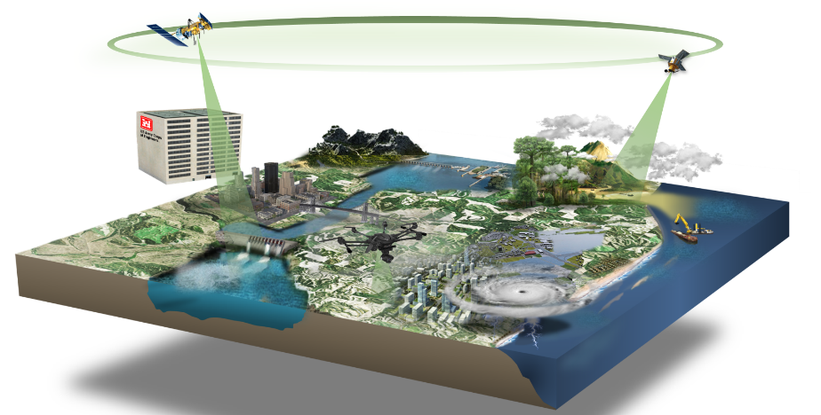
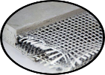
USACE CW R&D Strategic Focus Areas (SFAs): Capabilities
Sustainable Species Management
Prevention
Detection
Management
NextGen Water Resources Infrastructure
Performance Forecasting
Improved Resilience and Reliability
Automated Infrastructure Ops
Infrastructure Risk Quantification
Innovations in Sediment Management
Construction & Operations Technologies
Advanced Sensors & Monitoring
Engineering With Nature®
Nanomaterials
Pallid
Sturgeon
Live
Monitoring
HAB
Robotic
Dredging
Comprehensive
Hydro-Terrestrial
Risk Management
Real-time National Simulation Framework
Integrated Earth Observations
Risk-Informed Decision Support
Crisis Mitigation Response
Advanced Reconnaissance Technologies
Multi-Hazard Crisis Modeling
Risk Science & Communication
Advanced
Recon
I-4A: Innovative Applications of Big Data Analytics, AI, & Autonomy
Fully integrated NAV-FRM-ENV Trade-space Analytics - System of Systems
Sensor Integration, AI and Big Data Discovery
Advanced Robotic/Autonomous Technologies

Slide 13
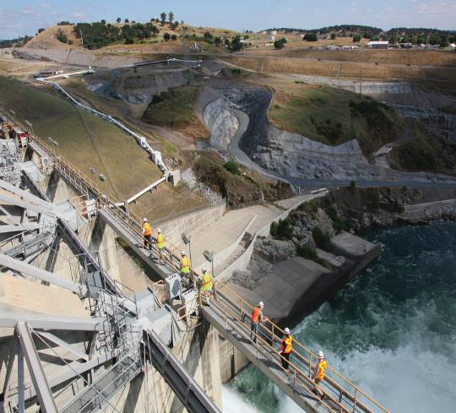
QUESTIONS?

